Slide 1

Climate Animations and Stop Motion Techniques
Animate for the Animals #3
3rd-5th Grade Lesson
Notes:
Gif by Lot Louisa via Giphy

Slide 2
Standards
Visual and Performing Arts
1.2.5.Cr1a Generate ideas for media artwork, using a variety of tools, methods and/or materials.
1.2.5.Cr1d Collaboratively form ideas, plans, and models to prepare for media artwork.
1.2.5.Cr2c Brainstorm goals and plans for a media art audience.
1.2.5.Cr3c Explore how elements and components can be altered for clear communication and intentional effects, points of view, perspective, and refine media artworks to improve clarity and purpose.
1.2.5.Pr4a Practice combining various academic arts, media forms, and content into unified media artworks such as animation, music and dance.
1.2.5.Re7b Identify, describe, explain and differentiate how various forms, methods and styles in media artworks affect and manage audience experience when addressing global issues including climate change.

Slide 3
Essential Questions
01
02
03
What effect did the climate stop motion animations and photography have on you?
What techniques are needed to create an engaging stop motion animation?
What techniques will you use in your own stop motion animation?

Slide 4
Learning Outcomes
I can
Understand the techniques used to make climate change animations and photography impactful.
I can
Identify photography and stop motion techniques in climate change photography and media artworks.
I can
Decide and plan techniques to include in their own project.

Slide 5



Agenda
Inquire
Investigate
Inspire
Notes:
Image by FreePik via FlatIcon
Image by FreePik via FlatIcon
Image by FreePik via FlatIcon

Slide 6
Inquire
~10 minutes
Notes:
Gif by Lot Louisa via Giphy
Image by FreePik via FlatIcon

Slide 7
Inquire
New Vocabulary
stop mo-tion
cinematic technique of repeatedly taking photos of an object in different positions to create the appearance of movement
stop
mo-
-tion
move
action, process of
Notes:
Students review the meaning of stop motion and learn the new word composition.

Slide 8
Inquire
New Vocabulary
com-po-si-tion
putting something together, based on elements or qualities
com-
-po-
-si-
-tion
together
placed
action, process of
Notes:
Students review the meaning of stop motion and learn the new word composition.

Slide 9
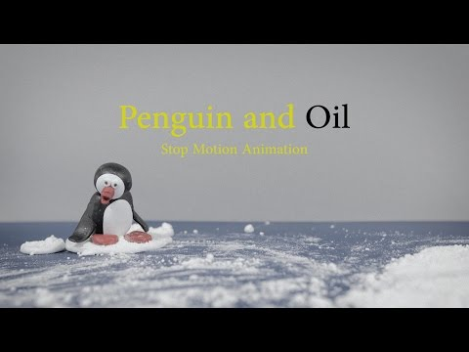
Inquire
Think About….
What is the video teaching me?
How is this video making me feel?
What techniques are being used?
Notes:
Students watch the stop motion videos Penguin and Oil and Climate Change Is Not Fun and rewatch the video Plastic Riptide.
Students discuss the meaning of the videos and evaluate the effectiveness of the stop motion techniques.
Teacher explains that stop motion animation requires good photography techniques to create an effective product.

Slide 10
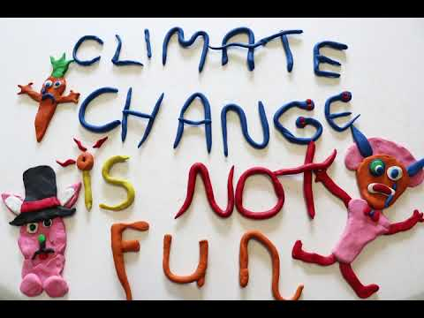
Inquire
Think About….
What is the video teaching me?
How is this video making me feel?
What techniques are being used?
Notes:
Students watch the stop motion videos Penguin and Oil and Climate Change Is Not Fun and rewatch the video Plastic Riptide.
Students discuss the meaning of the videos and evaluate the effectiveness of the stop motion techniques.
Teacher explains that stop motion animation requires good photography techniques to create an effective product.

Slide 11

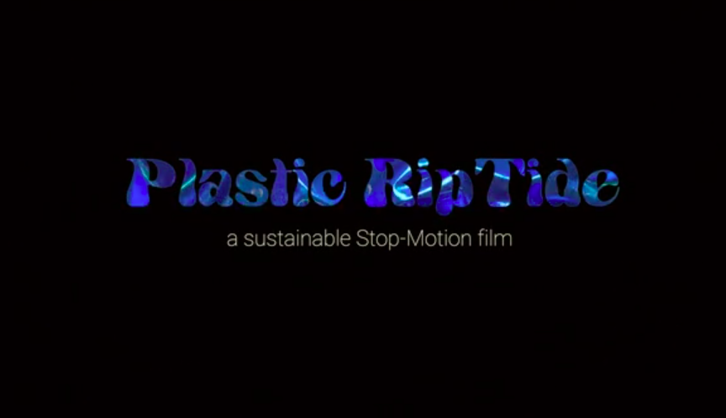
Inquire
Think About….
What is the video teaching me?
How is this video making me feel?
What techniques are being used?
Notes:
Students watch the stop motion videos Penguin and Oil and Climate Change Is Not Fun and rewatch the video Plastic Riptide.
Students discuss the meaning of the videos and evaluate the effectiveness of the stop motion techniques.
Teacher explains that stop motion animation requires good photography techniques to create an effective product.

Slide 12
Investigate
~25 minutes
Notes:
Gif by Lot Louisa via Giphy
Image by FreePik via FlatIcon

Slide 13
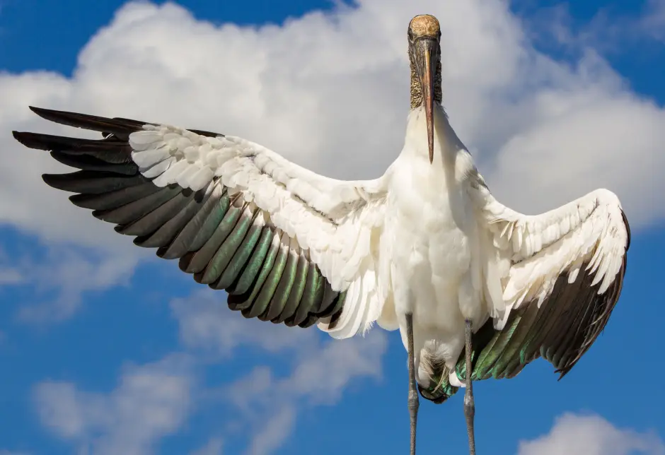
Camera Angle
Investigate
Tip: Photography rules are suggestions — they can be broken!
The position you hold the camera affects the way your viewer sees the photo.
If your camera is held up high, you photo subjects look small.
If you camera is held down low, your photo subjects look very large.
If your camera is held at eye level, your viewers can connect with your characters.
Notes:
Teacher uses the photograph to discuss with students camera angle, lighting, rule of odds, and rule of thirds.
Photo by Richard Johnson via Audubon Contest/Quartz Photos

Slide 14
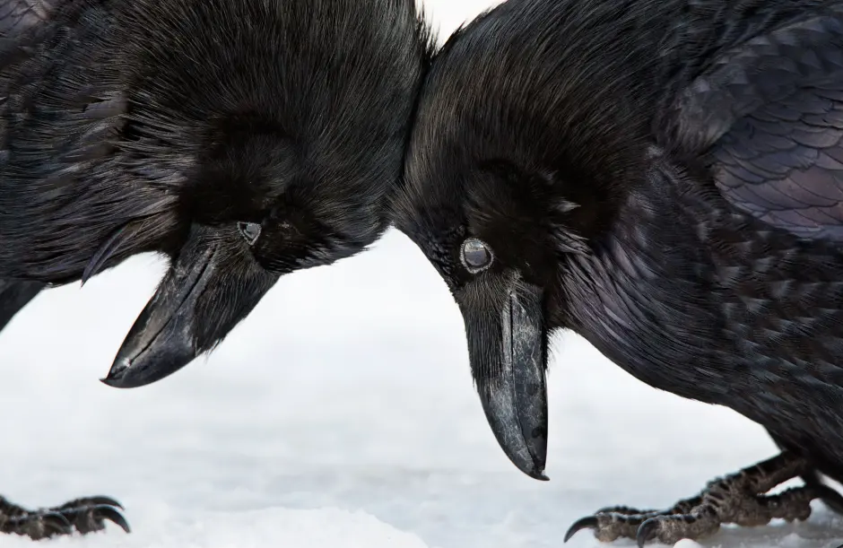
Camera Angle
Investigate
Tip: Photography rules are suggestions — they can be broken!
The position you hold the camera affects the way your viewer sees the photo.
If your camera is held up high, you photo subjects look small.
If you camera is held down low, your photo subjects look very large.
If your camera is held at eye level, your viewers can connect with your characters.
Notes:
Teacher uses the photograph to discuss with students camera angle, lighting, rule of odds, and rule of thirds.
Photo by Colleen Gara via Audubon Contest/Quartz Photos

Slide 15
Lighting
Investigate
Tip: Photography rules are suggestions — they can be broken!
Natural light is the best type for photography beginners.
The morning and afternoon are the best times for natural light, as the light is coming from an angle and not overhead.
Making sure the source of light is behind your subject will make sure your photos are clear.
Investigating the effects of light are best done with your camera by trying different lighting situations.
Notes:
Teacher uses the photograph to discuss with students camera angle, lighting, rule of odds, and rule of thirds.
Photo by Colleen Gara via Audubon Contest/Quartz Photos

Slide 16
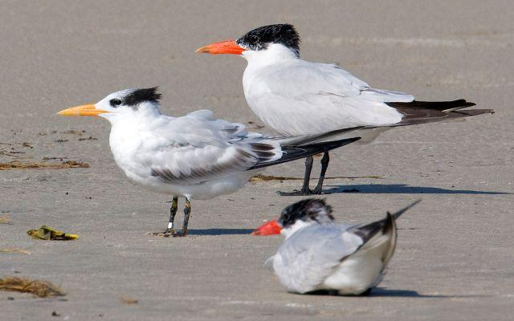
Rule of Odds
Tip: Photography rules are suggestions — they can be broken!
Investigate
Finding an odd number of focus points for your photography is more visually appealing to the viewer.
Notes:
Teacher uses the photograph to discuss with students camera angle, lighting, rule of odds, and rule of thirds.
Photo by John Ennis via Carolina Bird Club

Slide 17
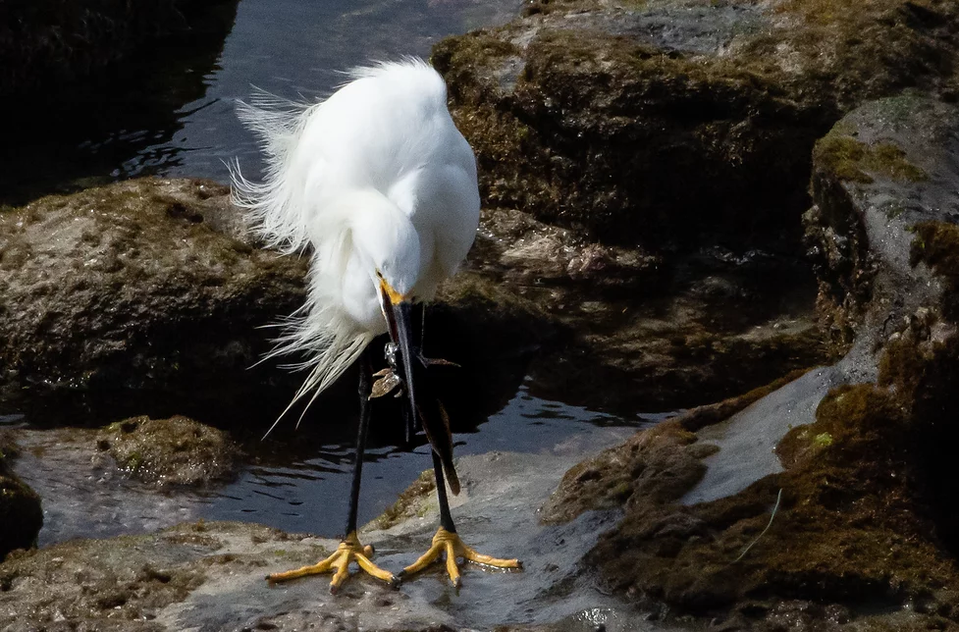
Rule of Thirds
Investigate
Tip: Photography rules are suggestions — they can be broken!
Divide your image into thirds, both vertically and horizontally.
Most cameras, iPads, and phones have this setting in the camera settings.
Place your subject at or near the intersecting lines to build composition.
You might choose to place your subject on the left or the right of the center frame.
Placing focus points (e.g., eyes) on the lines helps draw attention to them.
Notes:
Teacher uses the photograph to discuss with students camera angle, lighting, rule of odds, and rule of thirds.
Photo by NHillgarth Photography

Slide 18
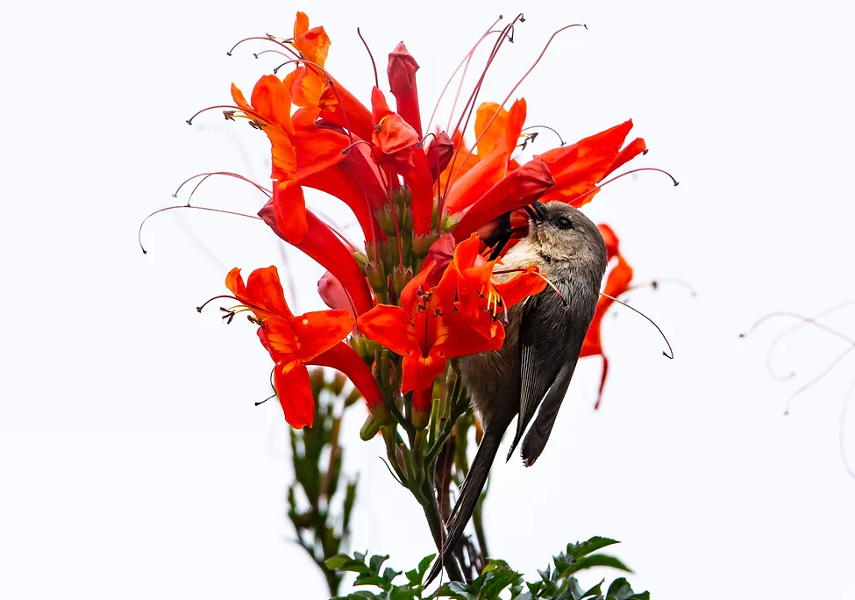
Rule of Thirds
Investigate
Tip: Photography rules are suggestions — they can be broken!
Divide your image into thirds, both vertically and horizontally.
Most cameras, iPads, and phones have this setting in the camera settings.
Place your subject at or near the intersecting lines to build composition.
You might choose to place your subject on the left or the right of the center frame.
Placing focus points (e.g., eyes) on the lines helps draw attention to them.
Notes:
Teacher uses the photograph to discuss with students camera angle, lighting, rule of odds, and rule of thirds.
Photo by NHillgarth Photography

Slide 19
Rule of Thirds
Investigate
Tip: Photography rules are suggestions — they can be broken!
Divide your image into thirds, both vertically and horizontally.
Most cameras, iPads, and phones have this setting in the camera settings.
Place your subject at or near the intersecting lines to build composition.
You might choose to place your subject on the left or the right of the center frame.
Placing focus points (e.g., eyes) on the lines helps draw attention to them.
Notes:
Teacher uses the photograph to discuss with students camera angle, lighting, rule of odds, and rule of thirds.
Photo by John Ennis via Carolina Bird Club

Slide 20
Think about…
Investigate
The meaning/message the photographer is capturing.
Which techniques are being used:
camera angles
lighting
rule of odds
rule of thirds
What do you like/dislike about the photograph? Why?
Notes:
Students either use devices to access the photography collection The Urgency of Awe: 10 Striking Photos of Nature as the World Faces Climate Crises or the teacher shares the collection to the whole class.
Students complete a silent viewing of the photos using “Think About” prompts.
Teacher uses “Talk It Out” strategy to share ideas throughout the viewing by using the following steps:
Teacher calls out “Talk It Out” at random points in the activity.
Students discuss the photograph with a partner.
The discussion should include:
The photography techniques used
The message of the photo
Students’ likes and dislikes

Slide 21
Inspire
~15 minutes
Notes:
Gif by Lot Louisa via Giphy
Image by FreePik via FlatIcon

Slide 22
Reviewing Your Stop Motion Animation Plan
Inspire
Return to your groups for your stop animation project.
Use the Stop Motion Plan Review to think about photography techniques to use in your stop motion animation.
Notes:
Students return to their stop motion animation groups from the previous lesson.
Students use the Stop Motion Plan Review to add details about what photography techniques they are going to add for a more effective stop motion animation.

Slide 23
Glossary
composition
putting something together based on elements or qualities
endangered
not many left, close to extinction
stop motion
the cinematic technique of repeatedly taking photos of an object in different positions to create the appearance of movement

Slide 24







Share your journey with us!
@subjecttoclimate

Slide 25


Scan for our free newsletter!
Or click here to subscribe
to our newsletter!
Notes:
Image by storyset via FreePik

Slide 26
Creators & Collaborators
Authors
Scientist Reviewer
Image Resources
Template Slides:
SlidesGo
Images from:
FlatIcon, FreePik, Giphy, Quartz Photos, Carolina Bird Club, NHillgarth Photography
Monica Lilley
Joanna Walker M.S
Please leave this slide for attribution.

